Slide 1
Credit Card Financial Insights
Power BI Project

Slide 2
Credit Card Transaction Insights
KPIs
The Total Revenue Generated is 57M
The Total Transaction Amount is 46M
The Total Interest Earned is 8M
The Total number of Transaction Counts is 667.2K

Slide 3
Men generated 54.73% of the revenue, amounting to $31M, followed by women, who generated 45.27% or $26M.
Q4 generated the highest revenue of $14.5M, with the greatest transaction count of 173.2K.
The Blue Card has been the most popular card category, generating $47M in revenue.
Other card categories have not been as popular among customers, with Silver generating only $6M, Gold $3M, and Platinum $1M.
Most customers use their cards to pay bills, generating $14M in revenue, followed by entertainment and fuel, each generating $10M.
We receive 52.80% of our revenue from the high-income group.
Our customers are mostly people who have graduated or completed high school.
Customers prefer to use the swipe method for their credit card transactions.

Slide 4
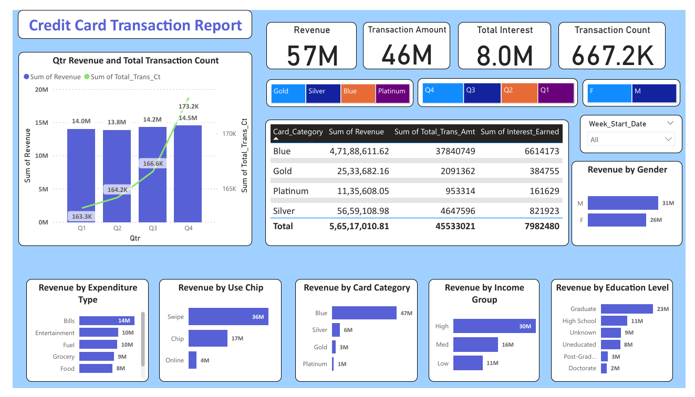

Slide 5
Credit Card Customer Insights
KPIs
The Total Revenue Generated is 57M
The Average Income of Customers is 57K
The Customer Satisfaction Score (CSS) is 3.2
The Customer count is 10.3K

Slide 6
The top three states that generate the most revenue are Texas, New York, and California, each generating $13M.
Customers between the ages of 40 and 50 generate the highest revenue, totaling $25M.
Married customers generate $29M in revenue, followed by singles, who generate $24M.
Most of our revenue is generated by customers who are businessmen or work in white-collar jobs.
Customers with two or three dependents generate the highest revenue.

Slide 7
